Slide 1


ANTI-MONEY LAUNDERING DETECTION USING GRAPH NEURAL NETWORKS FOR FINANCIAL TRANSACTION ANALYSIS
PROJECT DETAILS
PROJECT MEMBERS:
GADDAM VAISHNAVI REDDY – 2520030247
GV MADHAV- 2520030568
RICHIE KIRAN -2520030498
COURSE
Machine Learning
COURSE CODE
25SC2107E
SECTION / BRANCH
Section 4 • CSE
GUIDED BY
Ms. Jyothsna Datti

Slide 2
ABSTRACT
Project motivation and proposed learning strategy
Money laundering has become an increasingly sophisticated financial crime that enables illegal activities such as fraud, terrorism financing, corruption, and cybercrime. Conventional Anti-Money Laundering (AML) systems primarily rely on predefined rules and manual investigation, making them less effective in identifying complex and evolving money laundering patterns. With the rapid growth of digital banking, cryptocurrency transactions, and interconnected financial networks, there is a growing need for intelligent detection methods. Recent advances in Graph Neural Networks (GNNs) have demonstrated significant potential in addressing this challenge by representing financial ecosystems as graphs, where accounts are modeled as nodes and transactions as edges. This study presents a comprehensive overview of recent research on AML detection using GNN-based techniques, including Graph Convolutional Networks (GCN), Graph Attention Networks (GAT), GraphSAGE, and other graph learning approaches. The literature indicates how these models effectively capture structural and contextual information within transaction networks, allowing them to identify suspicious activities that traditional machine learning methods often overlook. Widely adopted benchmark datasets, such as the Elliptic Bitcoin Dataset and AMLSim, have further accelerated research by providing realistic environments for evaluating detection performance. Despite promising improvements in accuracy, precision, and recall, challenges remain, including severe class imbalance, limited availability of real-world labeled data, scalability to massive transaction graphs, privacy constraints, and the need for explainable predictions that support regulatory compliance. The review also highlights emerging research directions such as heterogeneous graph learning, temporal neural networks, self-supervised representation learning, and explainable artificial intelligence, which aim to improve both detection capability and model transparency. Overall, Graph Neural Networks represent a transformative approach to AML by leveraging the relational nature of financial transactions, enabling earlier identification of illicit activities while reducing false positives. Continued research integrating advanced graph learning techniques is expected to result in strengthening financial security and supporting more effective anti-money laundering systems in modern digital economies.

Slide 3


INTRODUCTION
Why a hybrid LSTM–Autoencoder architecture is relevant
WHY IT MATTERS
WHY MACHINE LEARNING MODELS
Traditional rule-based AML systems may miss complex and changing patterns. Machine Learning, especially Graph Neural Networks (GNNs), can analyze relationships between accounts and transactions to identify unusual patterns and improve the detection of potentially fraudulent activities.
Money laundering is a major financial crime that hides illegal money through complex transactions. As digital banking and online transactions increase, detecting suspicious activities quickly has become more difficult.
AGRICULTUR
DATA
EST

Slide 4
REQUIREMENT ANALYSIS
Core tools needed to execute the proposed pipeline
Python 3.x
Programming language used for data preprocessing, model training, graph construction, and prediction.
Pandas / NumPy
Used for data handling, cleaning, numerical operations, and transaction dataset preparation.
PyTorch / PyTorch Geometric
Used to build and train Graph Neural Network (GNN) models for analyzing relationships between financial accounts and transactions.
Jupyter / Google Colab
Interactive environment for dataset analysis, model development, training, testing, and visualization.
Bottom/extra requirement
Dataset → Financial transaction dataset containing sender, receiver, transaction amount, time, and fraud/AML-related labels for detecting suspicious transaction patterns.

Slide 5
LITERATURE REVIEW • PART 1
Papers 1–4
Paper / Year | Dataset | Methodology | Limitation
1. Mark Weber; Giacomo Domeniconi; Jie Chen; Daniel K. I. Weidele; Claudio Bellei; Tom Robinson; Charles E. Leiserson • 2019 Anti-Money Laundering in Bitcoin: Experimenting with Graph Convolutional Networks for Financial Forensics | Elliptic Bitcoin Dataset | Compared Logistic Regression, Random Forest, MLP and GCN for illicit-transaction classification; introduced the Elliptic transaction graph. | Real-world labeled AML data is scarce; the graph is large and dynamic; explainability is difficult; tested GCN variants did not consistently outperform simpler baselines.
2. Ismail Alarab; Simant Prakoonwit; M. I. Nacer • 2020 Competence of Graph Convolutional Network in Anti-Money Laundering in Bitcoin Blockchain | Elliptic Bitcoin Dataset | Combined graph-convolution node embeddings with node features and an MLP for illicit-transaction classification. | Focused on one Bitcoin dataset; dependent on Elliptic labels/features; temporal evolution is not fully modeled.
3. Wai Weng Lo; Gayan K. Kulatilleke; Mohanad Sarhan; Siamak Layeghy; Marius Portmann • 2023 Inspection-L: Self-Supervised GNN Node Embeddings for Money Laundering Detection in Bitcoin | Elliptic Bitcoin Dataset | Used Deep Graph Infomax with a Graph Isomorphism Network to learn self-supervised node embeddings, followed by classification. | Still evaluated mainly in the Elliptic Bitcoin setting; final detection still needs labels; generalization to private banking data remains open.
4. Ismail Alarab; Simant Prakoonwit • 2023 Graph-Based LSTM for Anti-money Laundering: Experimenting Temporal Graph Convolutional Network with Bitcoin Data | Elliptic Bitcoin Dataset | Combined LSTM with GCN to incorporate temporal information and used active learning for illicit transaction classification. | Temporal modeling increases complexity; evaluation is focused on Bitcoin rather than diverse banking transaction networks.

Slide 6
LITERATURE REVIEW • PART 2
Papers 5–8
Paper / Year | Dataset | Methodology | Limitation
5. Mohan et al. • 2023 Improving Anti-Money Laundering in Bitcoin Using Evolving Graph Convolutions and Deep Neural Decision Forest | Elliptic Bitcoin Dataset | Combined evolving/dynamic GCN with a Deep Neural Decision Forest and knowledge distillation for illicit-transaction classification. | More complex and computationally demanding than static GNNs; evaluation is centered on Bitcoin and one major benchmark dataset.
6. Claudio Bellei; Muhua Xu; Ross Phillips; Tom Robinson; Mark Weber; Tim Kaler; Charles E. Leiserson; Arvind; Jie Chen • 2024 The Shape of Money Laundering: Subgraph Representation Learning on the Blockchain with the Elliptic2 Dataset | Elliptic2 Dataset | Used subgraph representation learning to capture laundering patterns at the subgraph level instead of only classifying individual nodes. | Very large-scale subgraph processing is computationally demanding; cryptocurrency focus may limit direct banking-AML generalization.
7. Authors of RPGE study • 2024 A Plug-and-Play Data-Driven Approach for Anti-Money Laundering in Bitcoin | Bitcoin transaction data / Elliptic | Proposed Reachability Preserving Graph Embedding (RPGE) to extract AML-related transaction representations and integrate them with GNN methods. | Still Bitcoin-focused; embedding quality depends on the constructed reachability network; cross-domain validation is needed.
8. Hanbin Lu; Haosen Wang • 2024 Graph Contrastive Pre-training for Anti-money Laundering | Elliptic Dataset and AMLworld | Proposed GCPAL using graph contrastive pre-training with stochastic graph views and a KNN view to reduce dependence on labeled data. | Graph augmentation and contrastive training add complexity; performance depends on suitable graph views and hyperparameters.

Slide 7
LITERATURE REVIEW • PART 3
Papers 9–12
Paper / Year | Dataset | Methodology | Limitation
9. Kathleen Wu • 2026 Graph-Based Anti-Money Laundering in Bitcoin | Elliptic Dataset | Compared Logistic Regression, Random Forest, XGBoost, MLP, GCN, GraphSAGE and GAT/GATv2 for illicit Bitcoin transaction detection. | Focused on a single public Bitcoin dataset; findings may not generalize to private banking transaction data.
10. Meng Li; Lu Jia; XinQiao Su • 2025 Global-local Graph Attention with Cyclic Pseudo-labels for Bitcoin Anti-Money Laundering Detection | Bitcoin transaction graph / Elliptic | Used global-local graph attention with cyclic pseudo-label generation to improve detection of complex illicit transaction patterns. | Pseudo-label quality can affect learning; Bitcoin-focused evaluation and model complexity may limit deployment.
11. Ziqian Lin et al. • 2026 Detecting Illicit Transactions in Bitcoin: A Wavelet-Temporal Graph Transformer Approach for Anti-Money Laundering | Elliptic Dataset | Proposed a wavelet-temporal graph approach combining frequency decomposition, temporal encoding and graph learning. | More computationally complex than standard GNNs; Bitcoin-only evaluation leaves cross-domain validation open.
12. Dawei Cheng; Yao Zou; Sheng Xiang; Changjun Jiang • 2025 Graph Neural Networks for Financial Fraud Detection: A Review | Multiple financial fraud datasets from prior studies | Systematic review and taxonomy of GNN methods for financial fraud, covering relational, dynamic, heterogeneous and deployment aspects. | A review rather than a new detector; conclusions depend on the quality and comparability of previous studies.

Slide 8
LITERATURE REVIEW • PART 4
Papers 13–16
Paper / Year | Dataset | Methodology | Limitation
13. Soroor Motie; Bijan Raahemi • 2024 Financial Fraud Detection Using Graph Neural Networks: A Systematic Review | Literature covering banking, insurance, taxation, online payments and cryptocurrency | Systematically reviewed 388 unique articles and selected 33 studies, organizing GNNs by graph types, learning settings and anomaly levels. | Search and inclusion criteria may omit relevant studies; unsupervised, edge-level and graph-level detection remain underexplored.
14. Yingtong Dou; Zhiwei Liu; Li Sun; Yutong Deng; Hao Peng; Philip S. Yu • 2020 Enhancing Graph Neural Network-based Fraud Detectors against Camouflaged Fraudsters | YelpChi and Amazon fraud datasets | Introduced CARE-GNN using label-aware neighbor selection and reinforcement learning to handle feature and relation camouflage. | Designed for general fraud rather than AML; requires labeled fraud data and does not directly model temporal AML patterns.
15. Yang Liu; Xiang Ao; Zidi Qin; Jianfeng Chi; Jinghua Feng; Hao Yang; Qing He • 2021 Pick and Choose: A GNN-based Imbalanced Learning Approach for Fraud Detection | Alibaba/M7/M9 fraud datasets | Proposed PC-GNN with a pick-and-choose neighbor/mini-batch strategy to address severe class imbalance in fraud detection. | Targets general fraud rather than AML; extra sampling steps can add training complexity and depend on dataset structure.
16. Thomas N. Kipf; Max Welling • 2017 Semi-Supervised Classification with Graph Convolutional Networks | Cora, Citeseer and Pubmed citation networks | Introduced the GCN architecture, combining node features with local graph structure for semi-supervised node classification. | Not designed for AML; standard GCNs can suffer from over-smoothing and assume relatively stable graph structure.

Slide 9
LITERATURE REVIEW • PART 5
Papers 17–20
Paper / Year | Dataset | Methodology | Limitation
17. Petar Veličković; Guillem Cucurull; Arantxa Casanova; Adriana Romero; Pietro Liò; Yoshua Bengio • 2018 Graph Attention Networks | Cora, Citeseer, Pubmed and protein-interaction data | Introduced masked self-attention so nodes assign different importance to neighboring nodes during message passing. | Not AML-specific; attention increases computational complexity and original evaluation was on non-financial graph benchmarks.
18. William L. Hamilton; Rex Ying; Jure Leskovec • 2017 Inductive Representation Learning on Large Graphs | Reddit, citation networks and protein-protein interaction graphs | Introduced GraphSAGE, which samples and aggregates neighborhood information to generate embeddings for unseen nodes. | Not AML-specific; neighborhood sampling can lose information and performance depends on sampling strategy.
19. Keyulu Xu; Weihua Hu; Jure Leskovec; Stefanie Jegelka • 2019 How Powerful Are Graph Neural Networks? | Graph classification benchmark datasets | Developed the GIN architecture and a theoretical framework for GNN expressive power. | Theoretical expressiveness does not guarantee the best real-world AML performance; not designed specifically for financial transactions.
20. Jie Zhou; Ganqu Cui; Shengding Hu; Zhengyan Zhang; Cheng Yang; Zhiyuan Liu; Lifeng Wang; Changcheng Li; Maosong Sun • 2020 Graph Neural Networks: A Review of Methods and Applications | Multiple graph datasets from prior GNN research | Surveyed GNN architectures, message-passing strategies, training methods and applications. | Broad survey scope means AML-specific evidence is limited; it does not experimentally evaluate an AML detector.

Slide 10
LITERATURE REVIEW • PART 6
Papers 21–24
Paper / Year | Dataset | Methodology | Limitation
21. Ziwei Zhang; Peng Cui; Wenwu Zhu • 2018 Deep Learning on Graphs: A Survey | Multiple graph datasets from prior studies | Reviewed graph recurrent networks, graph convolutional networks, graph autoencoders, graph reinforcement learning and graph adversarial methods. | Broad survey rather than AML-specific experimentation; financial transaction constraints are not the main focus.
22. Shirui Pan et al. • 2020 A Comprehensive Survey on Graph Neural Networks | Multiple benchmark graph datasets | Presented a taxonomy covering recurrent, convolutional, graph autoencoder and spatial-temporal GNN families and their applications. | General-purpose survey; limited direct discussion of AML datasets, financial constraints and deployment.
23. Dawei Cheng; Yao Zou; Sheng Xiang; Changjun Jiang • 2025 Graph Learning-Empowered Financial Fraud Detection: Progress and Future Directions | Multiple financial fraud datasets from literature | Surveyed graph learning methods for financial fraud, emphasizing relational structure, transaction networks, heterogeneous/dynamic graphs and future research directions. | Review paper; practical deployment, data privacy and benchmarking across proprietary datasets remain open challenges.
24. Dawei Cheng; Yao Zou; Sheng Xiang; Changjun Jiang • 2025 Graph Neural Networks for Financial Fraud Detection: A Review (extended/revised source) | Multiple financial fraud datasets from prior studies | Organized GNN research by graph type, learning paradigm, fraud type and deployment considerations, with discussion of open problems. | Broad review; not a new detector and it cannot resolve the lack of high-quality public real-world AML labels.

Slide 11
LITERATURE REVIEW • PART 7
Papers 25–26
Paper / Year | Dataset | Methodology | Limitation
25. Mark Weber; Giacomo Domeniconi; Jie Chen et al. • 2019 Anti-Money Laundering in Bitcoin: Experimenting with Graph Convolutional Networks for Financial Forensics | Elliptic Bitcoin Dataset | Explored graph convolution and conventional machine-learning baselines for identifying illicit Bitcoin transactions and demonstrated the value of relational information. | Elliptic labels are incomplete and the public dataset does not capture all real-world banking AML conditions.
26. IBM Research • 2020 AMLSim: Synthetic Data Generation for Anti-Money Laundering Research | AMLSim synthetic banking transaction data | Generates synthetic banking transaction networks containing normal and predefined illicit behaviors for AML model development and evaluation. | Synthetic data cannot fully reproduce the complexity and distribution of real bank transactions; transferability to real-world institutions must be validated.

Slide 12
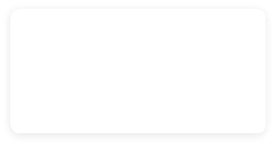

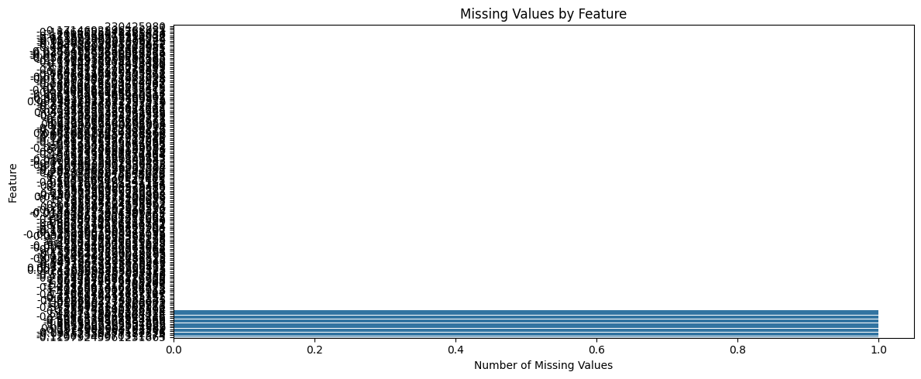
EDA • DATASET QUALITY
EDA of Elliptic transaction data
44,950
FEATURE ROWS
167
FEATURE COLUMNS
234,355
EDGES
15
MISSING VALUES
203,769
CLASS LABELS
EDA PROCESS
• Loaded class labels, transaction edges and feature data
• Checked dimensions, columns and data types
• Counted missing values in the feature dataset
• Examined licit, illicit and unknown classes
• Analyzed feature distributions and correlations
• Studied transaction connectivity

Slide 13
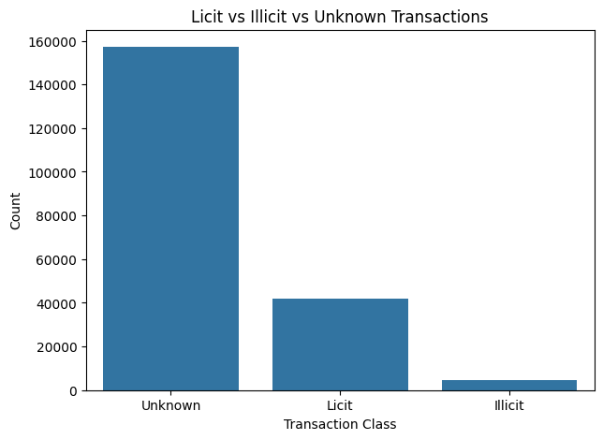

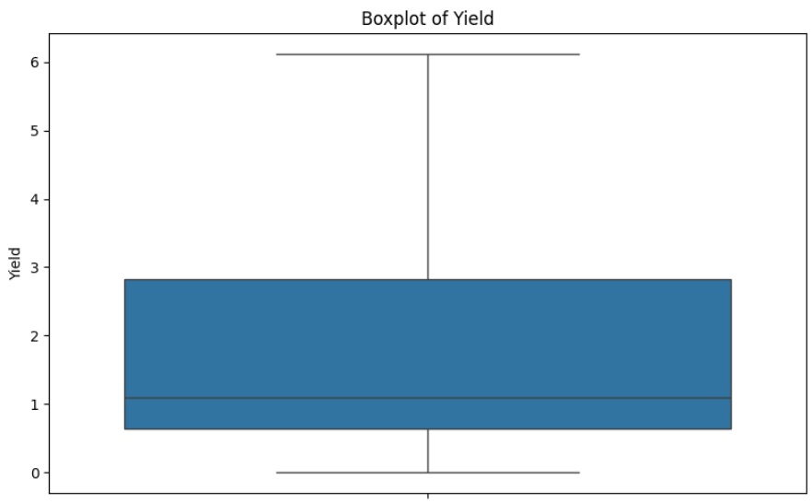
EDA • CLASS LABELS
Licit, illicit and unknown transaction labels
CLASS LABEL SUMMARY
203,769 total labels
157,205 • UNKNOWN
42,019 • LICIT
4,545 • ILLICIT
Illicit transactions form a small portion of the labelled data, making class imbalance an important consideration for AML model training and evaluation.

Slide 14
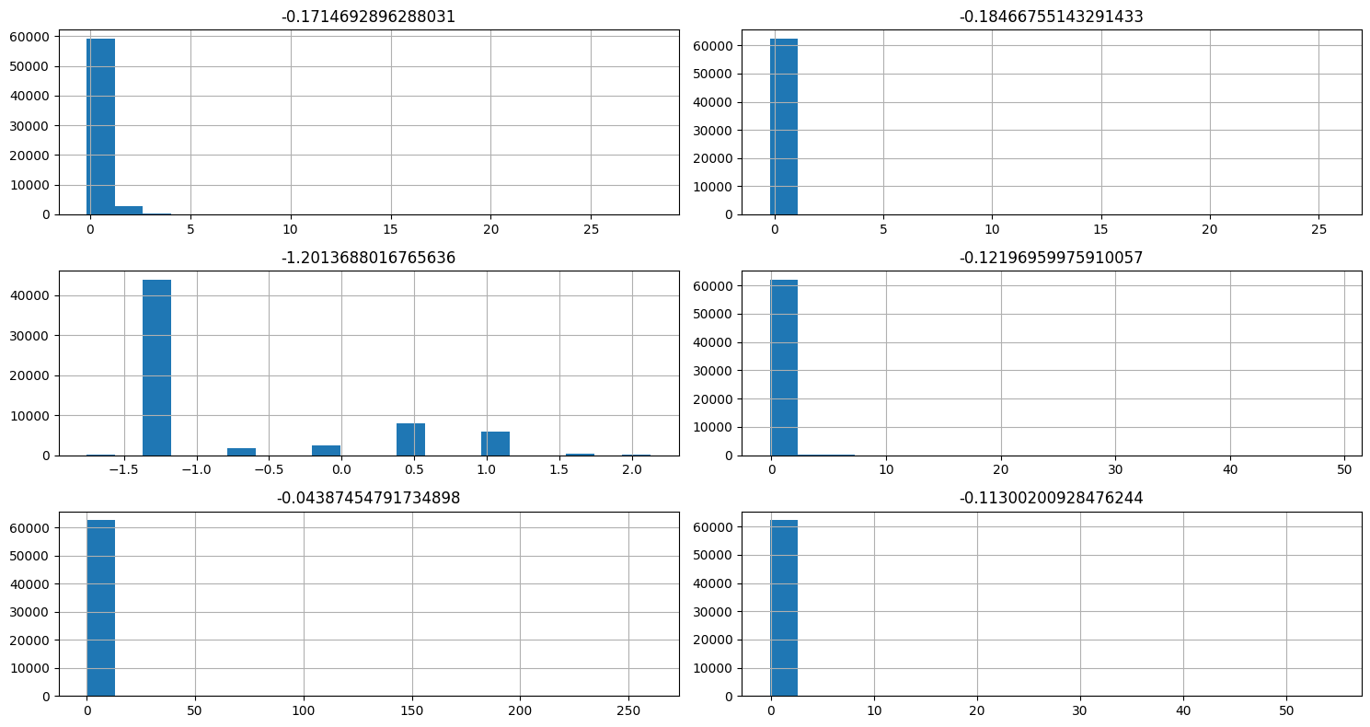

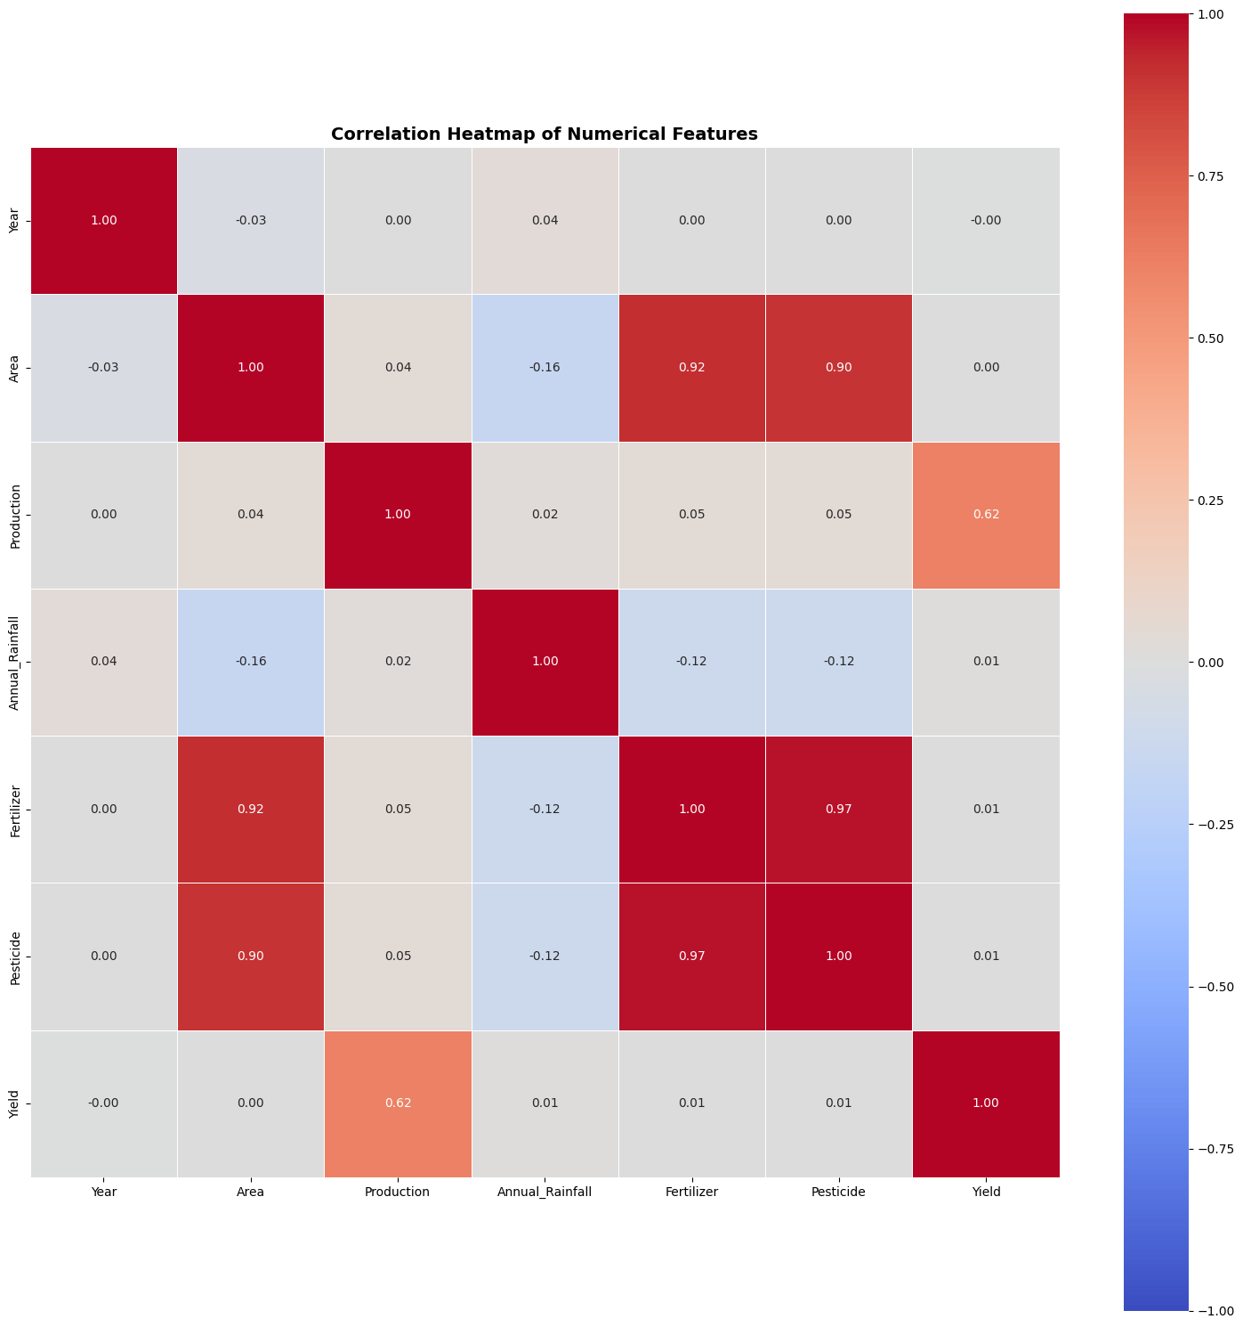
EDA • FEATURE DATA
Selected transaction feature distributions
WHAT THIS SHOWS
Selected numerical features show different distributions.
The plots reveal skewness, spread and unusual values.
These observations support preprocessing and feature preparation.
Plots use a 100,000-row sample of selected features.

Slide 15
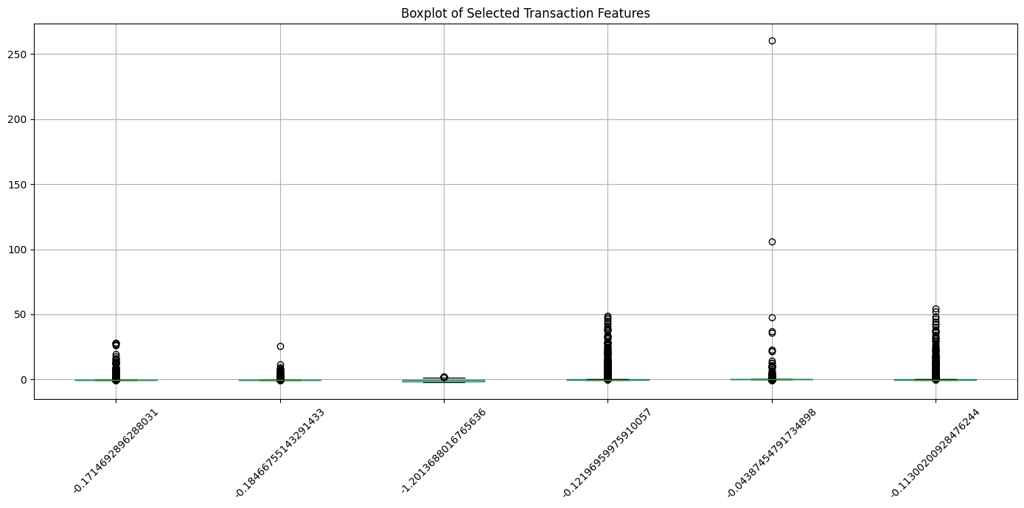
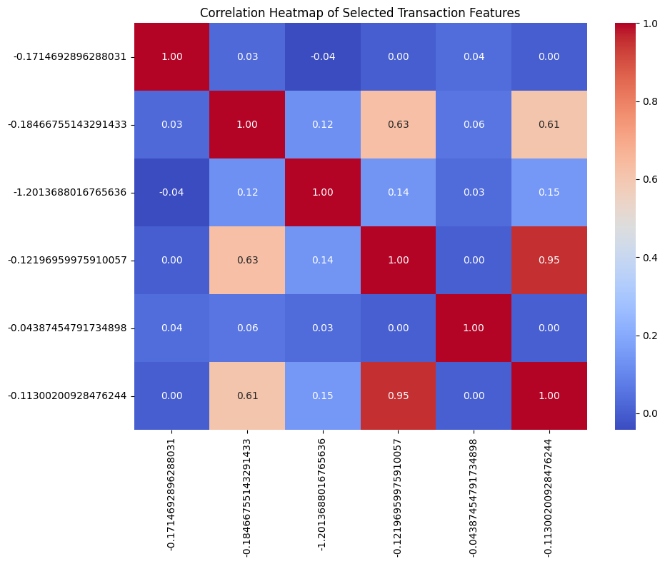
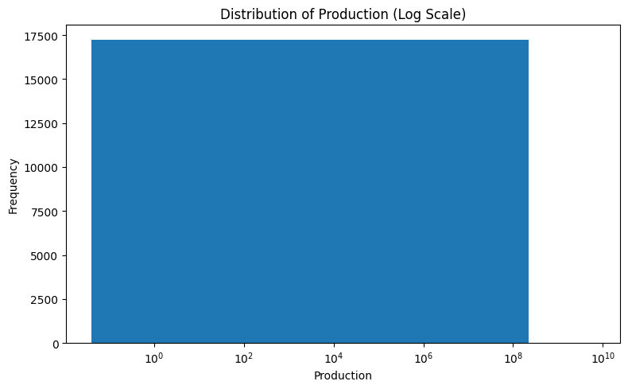
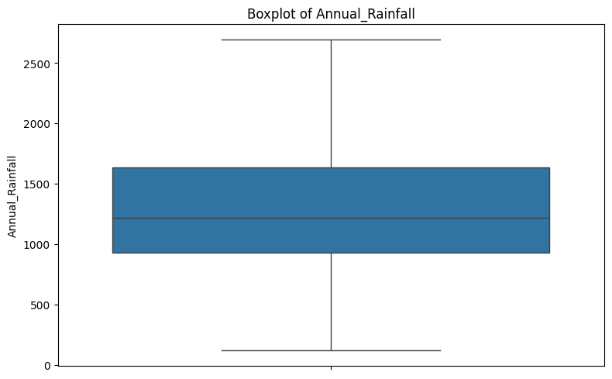
EDA • CORRELATION & OUTLIERS
Feature relationships and extreme values
SELECTED FEATURE BOXPLOT
CORRELATION HEATMAP

Slide 16
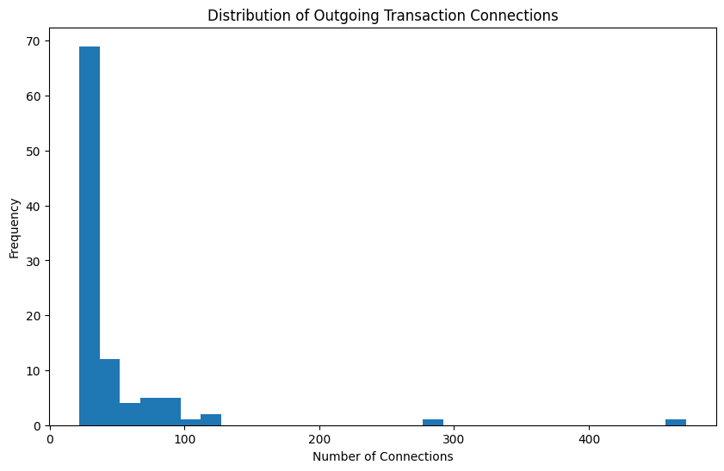

EDA • GRAPH STRUCTURE
Structure derived from the transaction edge list
GRAPH DATA
Elliptic transaction network
TRANSACTION EDGES 234,355
UNIQUE SOURCES 166,345
UNIQUE DESTINATIONS 148,447
AVG. OUTGOING CONNECTIONS 1.41
AVG. INCOMING CONNECTIONS 1.58
NETWORK OVERVIEW
The edge list stores transaction-to-transaction connections using txId1 and txId2. These relationships form the graph structure used for GNN-based AML analysis.
GRAPH DATA
NETWORK OVERVIEW
Elliptic transaction network
The edge list represents transaction-to-transaction connections using txId1 and txId2. These relationships are important for constructing the financial transaction graph used by GNN models.
TRANSACTION EDGES
234,355
UNIQUE SOURCES
166,345
UNIQUE DESTINATIONS
148,447
AVG. OUTGOING
1.41
AVG. INCOMING
1.58
TRANSACTION GRAPH

Slide 17


PROPOSED MODEL WORKFLOW
Hybrid temporal learning + reconstruction-based anomaly detection
3 4
1
2
5
6
DATASET
PREPROCESS
FEATURE PREPARATION
RANDOM FOREST
XGBOOST + SVR
MODEL COMPARISON
            Load the crop yield dataset containing agricultural and environmental features.
Clean the data and encode categorical features. Prepare the input variables for model training.
Select the relevant input features such as Year, State, Crop, Season, Area, Production, Annual Rainfall, Fertilizer, and Pesticide.
Train a Random Forest regression model to learn relationships between input features and crop yield.
Train XGBoost and Support Vector Regression (SVR) models for crop-yield prediction.
Compare the three models and select the best-performing model based on evaluation metrics.
Evaluation: MAE • MSE • RMSE • R² Score

Slide 18

CONCLUSION
Key takeaways from the project foundation
This project presents a machine learning-based approach for predicting crop yield using important agricultural and environmental factors such as crop type, area, production, rainfall, fertilizer, pesticide usage, year, state, and season. The dataset is cleaned and analyzed before applying Random Forest, XGBoost, and Support Vector Regression (SVR) models.
The performance of the models is compared using MAE, MSE, RMSE, and R² Score. The best-performing model can be selected based on these evaluation metrics to provide more reliable crop-yield predictions. The proposed system can support farmers and agricultural organizations in better planning, resource management, crop selection, irrigation, and fertilizer usage.
END OF PRESENTATION

